Slide 1
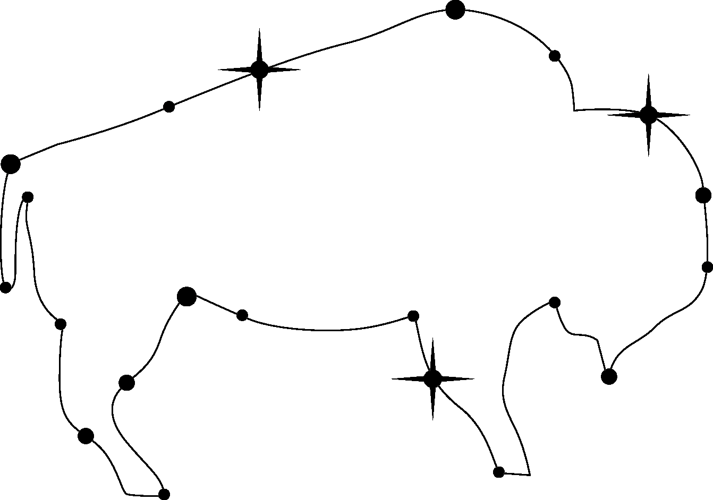

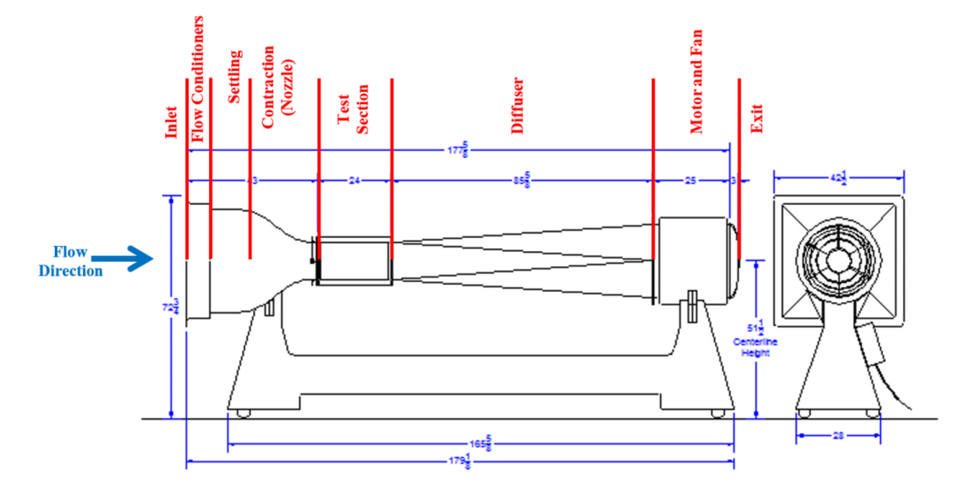
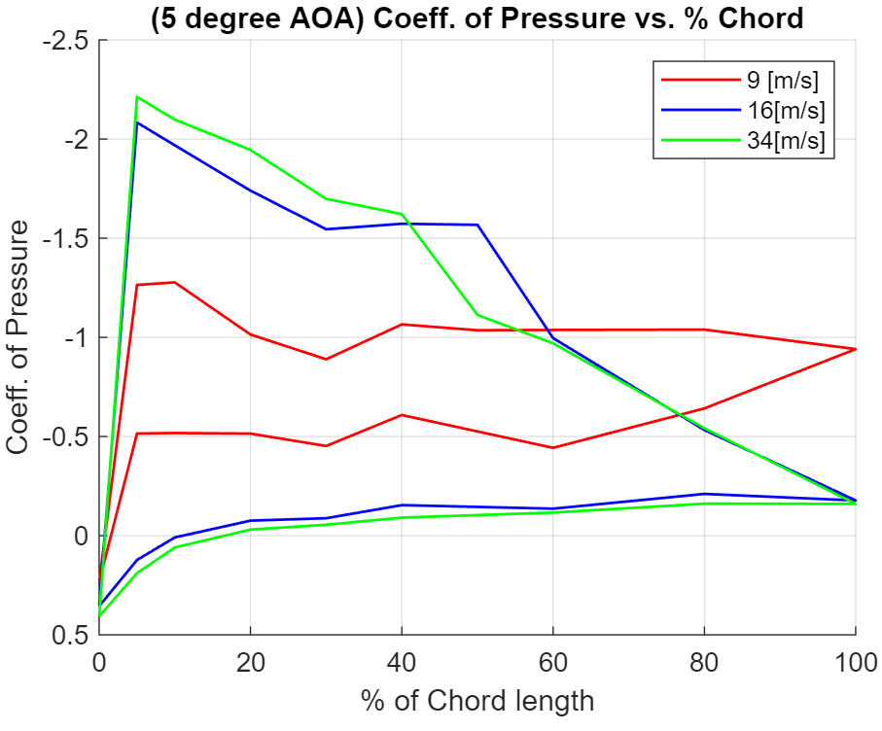
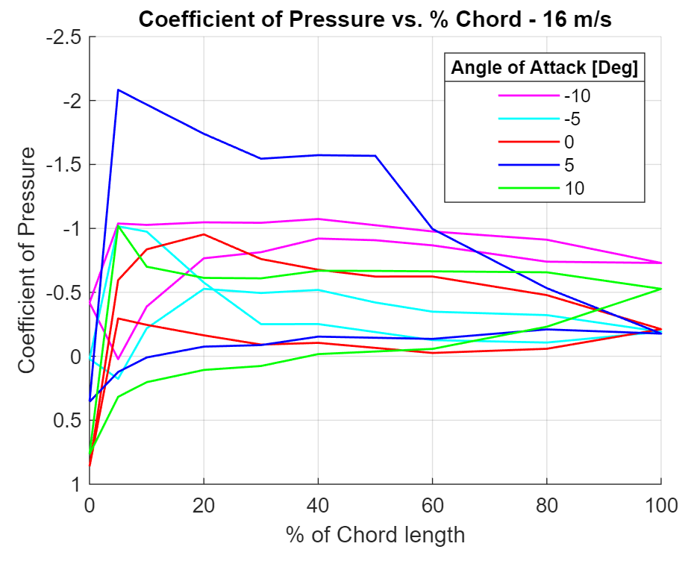
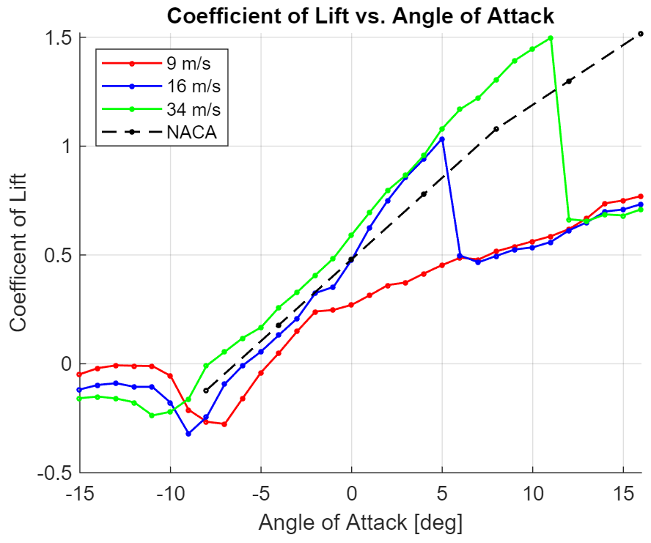
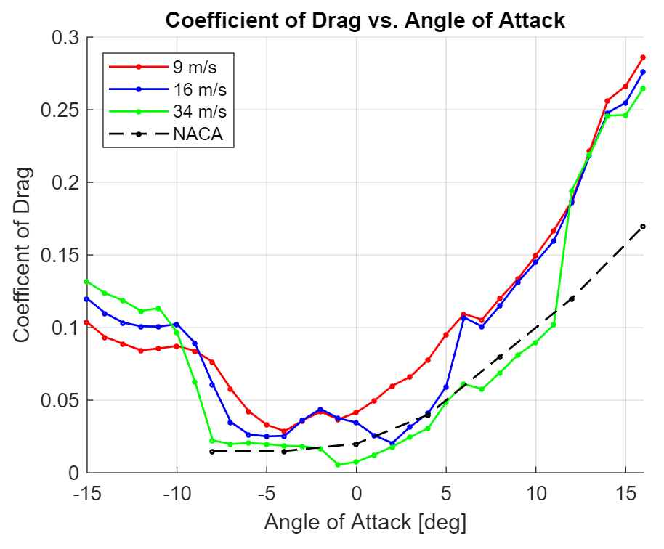
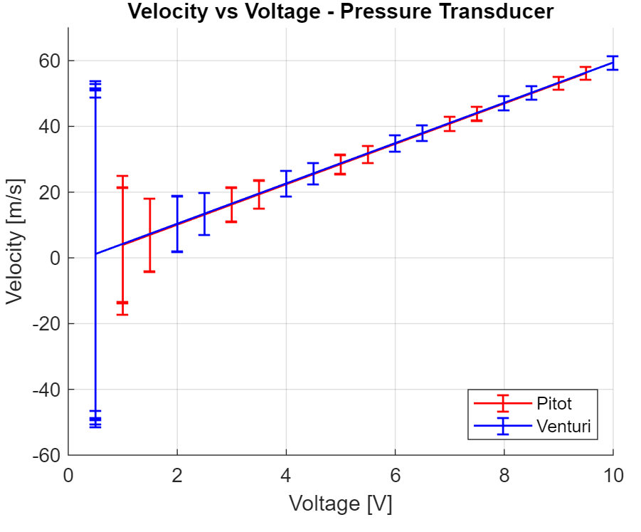
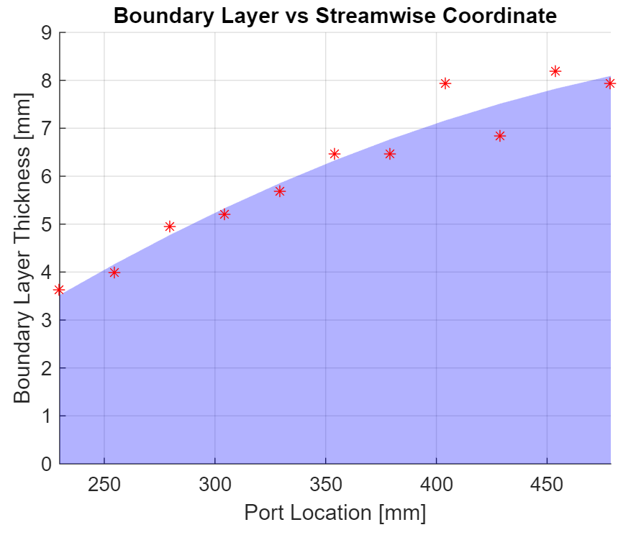
ASEN 2002: Aerodynamics of a Cambered Clark Y-14 Airfoil
Bennett Grow, Amanda Marlow, Zak Reichenbach, Cate Billings
Overview
Airfoil Static Pressure Coefficient Distribution
Motivation: To explore airflow in a wind tunnel and around cambered airfoils by applying fundamental laws of aerodynamics
Experimental Measurements: Measurement of airspeed, measurement of boundary layer, cambered airfoil aerodynamics
Configuration and Techniques:
Pressure differential increases with relative wind speed
Pressure differential increase with angle of attack until flow separation
Most of the variance in pressure occurs around 10% of the chord
Figure 4
Figure 5
Figure 1
Airspeed Calculation and Airspeed Model & Boundary Layer Influence
Lift and Pressure Drag Coefficients
Airspeed Measurements
velocity[m/s] = 6.14(voltage [V]) ‒ 2.03
Errors decrease as voltage increases
Boundary Layer
Turbulent
Increases along test section ~ from 3.5 to 8 mm thick
Coefficient of Lift vs. Angle of Attack
Stall angle of attack increases with relative wind speed
Coefficient of Drag vs. Angle of Attack
Coefficient of drag increases as the angle of attack moves farther from zero
Figure 6
Figure 7
Figure 2
Figure 3
11/20

